Slide 1
Project Alpha
The Case

Slide 2
Project Alpha – The case
Goal
Hands-on experience with
Scrum
C#
Git
Working in a team
Company Sharkshark
Wants a simple role playing game (RPG)
Must-haves
Made with C#
Using scrum
Should have
Game contains 9 locations
User friendly
Practical
Four week project
First demonstration: ma 16 sept ‘24
Deadline: wo 25 sept ’24 at 17.00
Team project 4 / 5 students

Slide 3
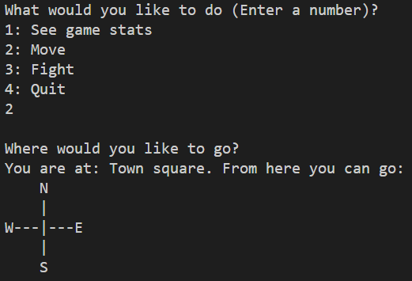
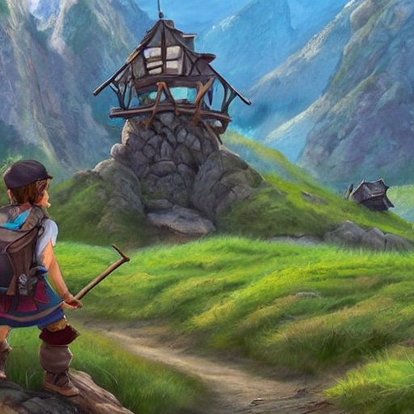
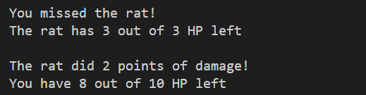
Simple RPG (Role playing game)

Slide 4
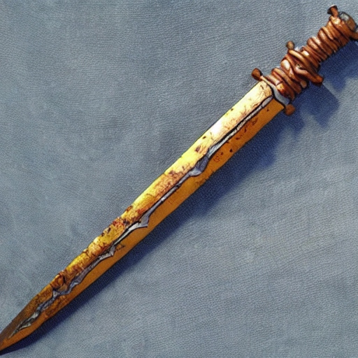
The Hero
You start off with a rusty sword
Serviceable, but perhaps you could find a better weapon?

Slide 5
The game - Map
The people in your town are being terrorized by giant spiders. You decide to do what you can to help.
Objective: complete all quests
Map:
Map with locations:
|
|
--+---
|
P
A
VFTGBS
H

Slide 6
The game - Legend
H: Your house (game start)
T: Town square
F: Farmer
V: Farmer’s field
A: Alchemist’s hut
P: Alchemist’s garden
G: Guard post
B: Bridge
S: Spider forest
P
A
VFTGBS
H

Slide 7

Quest: Clear the farmer’s field
P
A
VFTGBS
H
Given by Farmer (F)
Kill snakes in the farmer’s field (V)
Killing three snakes will complete the quest
“I can't w'rk mine own landeth with those pesky snakes slith'ring 'round! Shall thee holp me?”

Slide 8
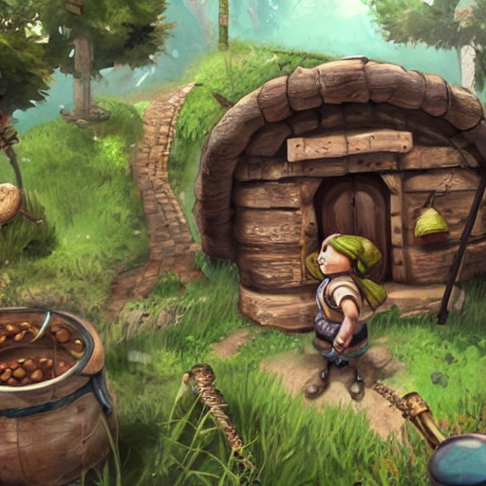
Quest: Clear the alchemist’s garden
P
A
VFTGBS
H
Given by Alchemist (A)
Kill rats in the alchemist’s garden (P)
Killing three rats will complete the quest
“Those rats art nibbling on mine own h'rbs! I couldst very much useth an adventur'r to taketh careth of those folk …”

Slide 9
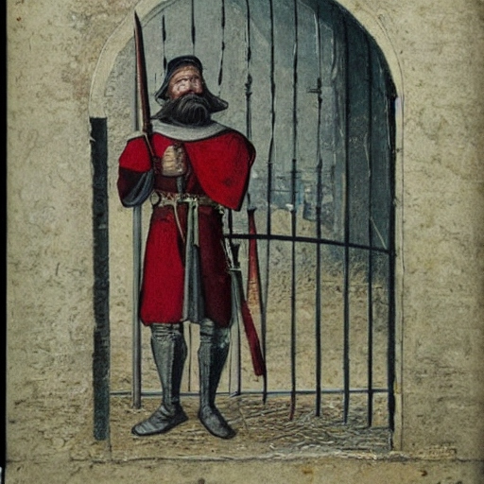
Guard’s post
P
A
VFTGBS
H
You need to have finished the other two quests before passing the guard (G)
“Turn back at once, peasant! Unless thee hast proof of thy grit.”

Slide 10
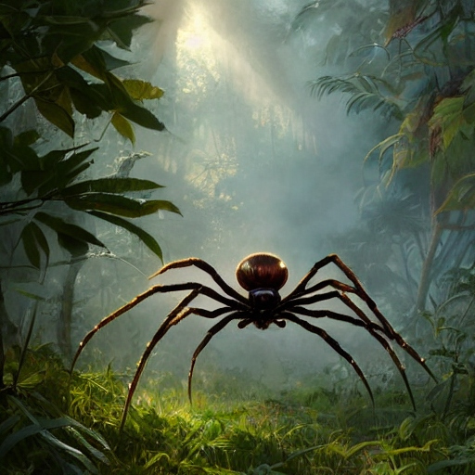
Quest: Collect spider silk
P
A
VFTGBS
H
Received when reaching the bridge (B)
Kill spiders in the spider forest (S)
The game is won when you have killed three spiders
“I shalt releaseth the town folks of their feareth!”

Slide 11
Scope
Must be built in C# (.NET 8)
Must be console-based
GitHub must be used
Scrum must be used
VSCode/VS must be used
World.cs must be used as a code base
(Feel free to edit World.cs to your needs)
Must be built using OODP

Slide 12
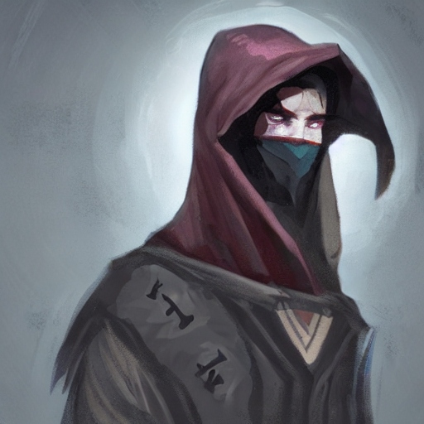
Questions?
The dungeon master shall provide thou with answers

Slide 13
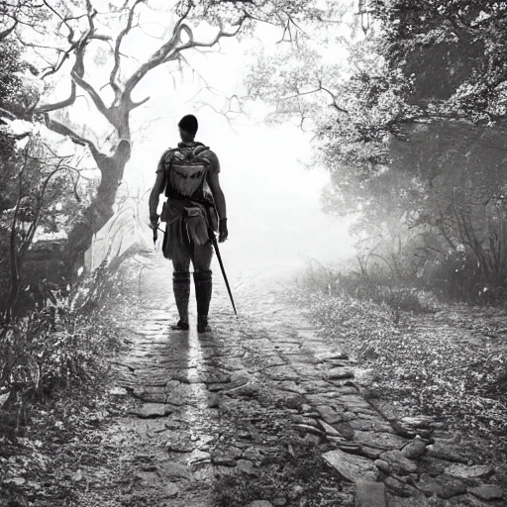
Embark on thy quest, adventur'r!
All illustrations created using deepai.org

Slide 14
Documents
Codebase will be shared
World.cs is used to create:
Locations
Monsters
Weapons
Quests
Product backlog will be shared

